Slide 1

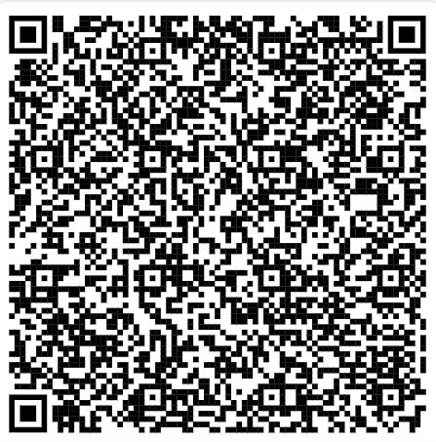
Innovate, Automate and Elevate Harnessing the Power of AI
Orange County Superior Court, California
Presented by
Deepak Shisode (Court Technology Manager):
Document Intelligence with Generative AI
Bryan Hernandez (Lead Data Scientist):
Strategic Innovations
Jorge Lichtenstein (Lead Developer – Criminal & Traffic CMS):
Technology transformation
2025.11.12 - Code for Justice Conference

Slide 2
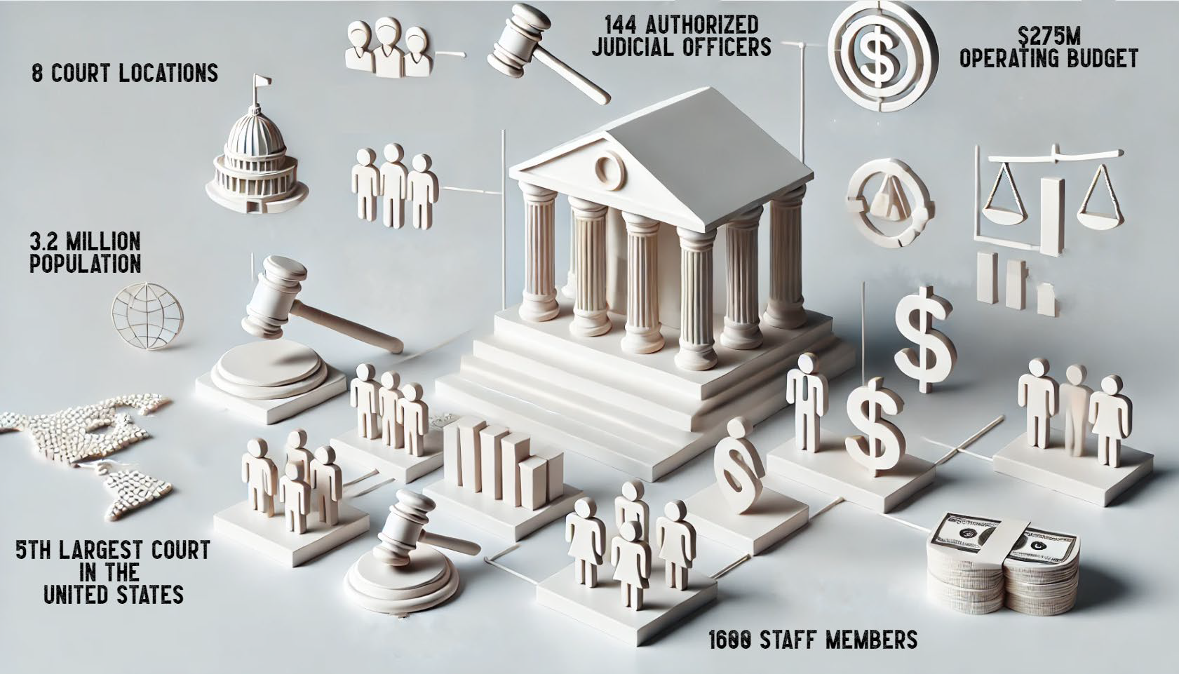
ORANGE COUNTY SUPERIOR COURT AT A GLANCE

Slide 3
Challenges and Opportunities
Courts rely heavily on Forms and Documents for Case Processing
Case Processing goes through lot of manual steps to identify issues with the Forms
Traditional programming couldn’t extract structured and unstructured data from PDFs.

Slide 4
Resolution
The Shift: Manual Review → AI-Augmented Decisioning
BEFORE (Challenges) | AFTER (Improvements with Document Intelligence Platform)
High Manual Effort Clerks manually review filings Rule interpretation done by humans Manual Notification data collection | AI-Driven Automation OCR via Azure Forms Recognizer GPT/AI model analyzes sections using micro-prompts RAG ensures context accuracy
Slow & Inconsistent Turnaround Processing time varies by staff load Human fatigue causes inconsistency | Faster, Consistent Processing Automated validation Clerk sees summarized outcomes, not raw documents
Roadmap (for future use cases)
Rigid Rule Management • Rules embedded inside CMS • Changes require developer intervention | LLM-Powered Dynamic Rules • Rules managed outside CMS • LLM interprets and applies rules on demand
Compliance Risks • Missing signatures/fields often missed • Manual redaction needed | LLM-Powered Dynamic Rules • Rules managed outside CMS • LLM interprets and applies rules on demand

Slide 5
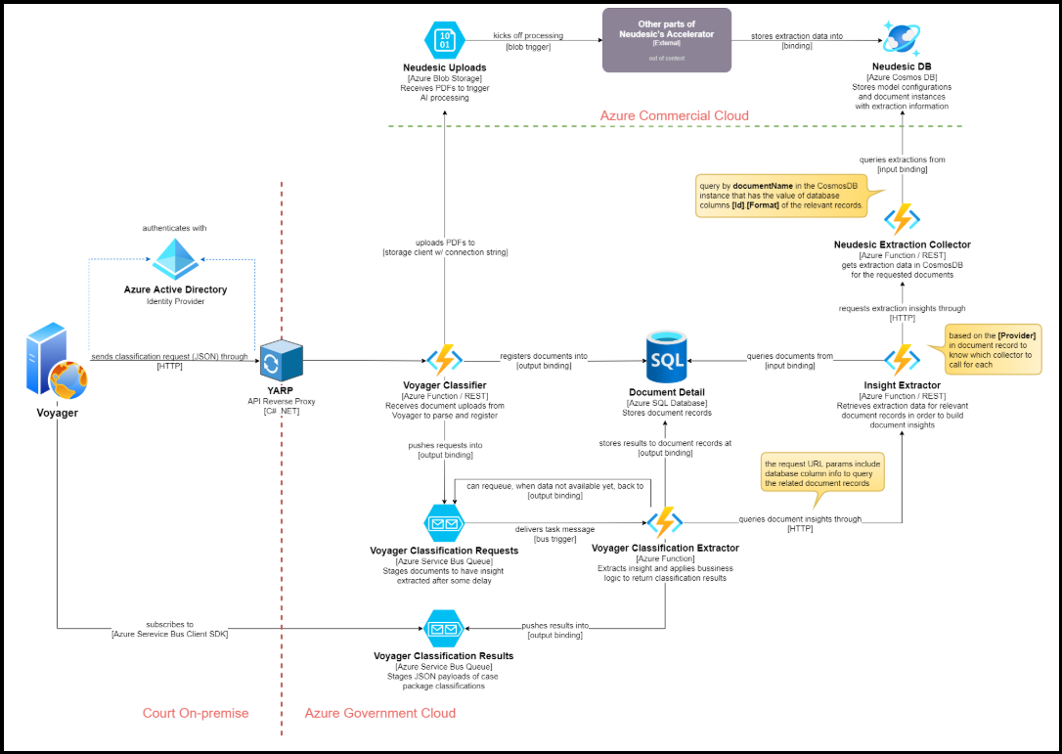
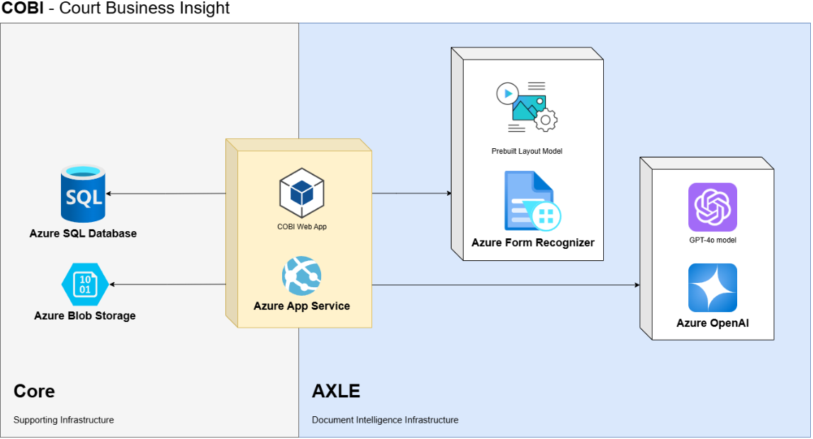
Timeline
AI Journey at OC Courts (2021–2025+)
Phase 0 (2021–2023): Machine Learning Exploration – Microsoft ML Studio, Production in Aug 2023. High infra cost ($2.5k/mo)
Phase I (2023–2024): ChatGPT released in Nov 2022.
OC LLM Transition – Azure OpenAI, RAG, Production in Nov 2024
Phase II (2024–2025): Name Change AI: OCR + Rules Engine + Clerk Review Module (70% time savings)
Phase III (2025): Request for Dismissal – Signature Detection (LLM Vision)
Future (2025+): Redaction + AI Rule Reasoning

Slide 6
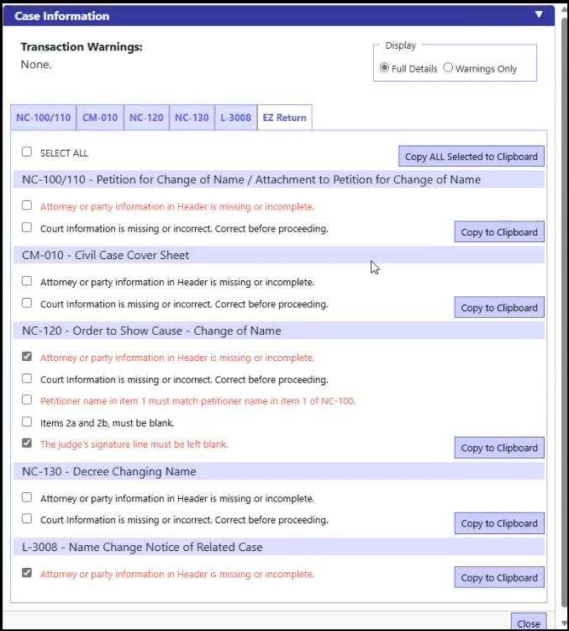
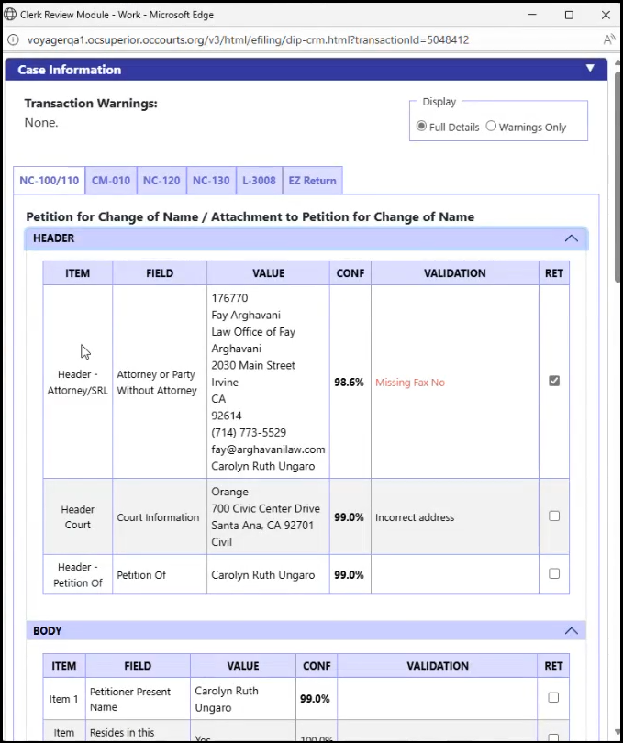
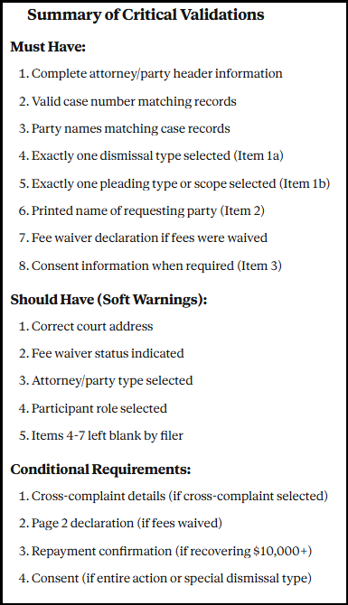
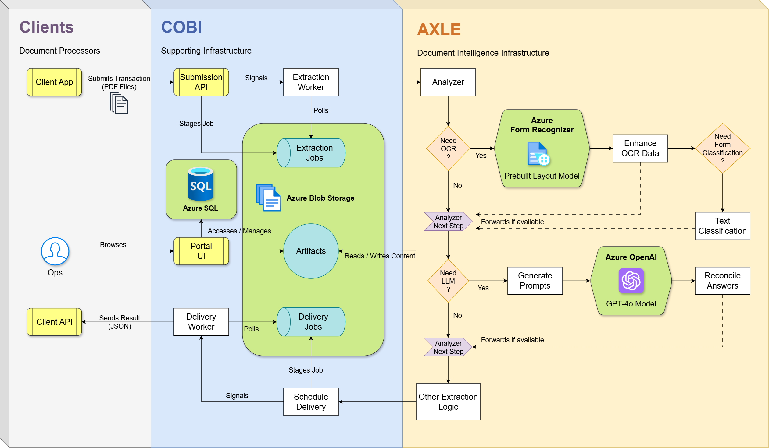
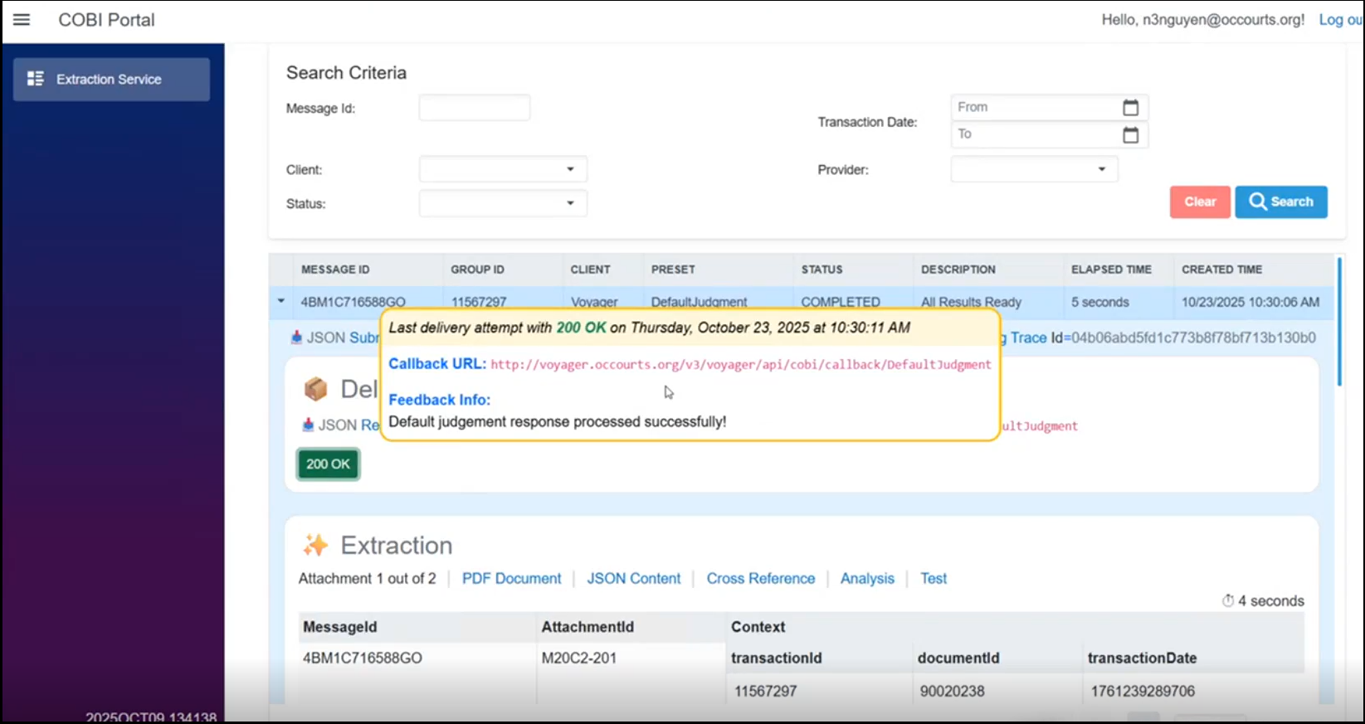
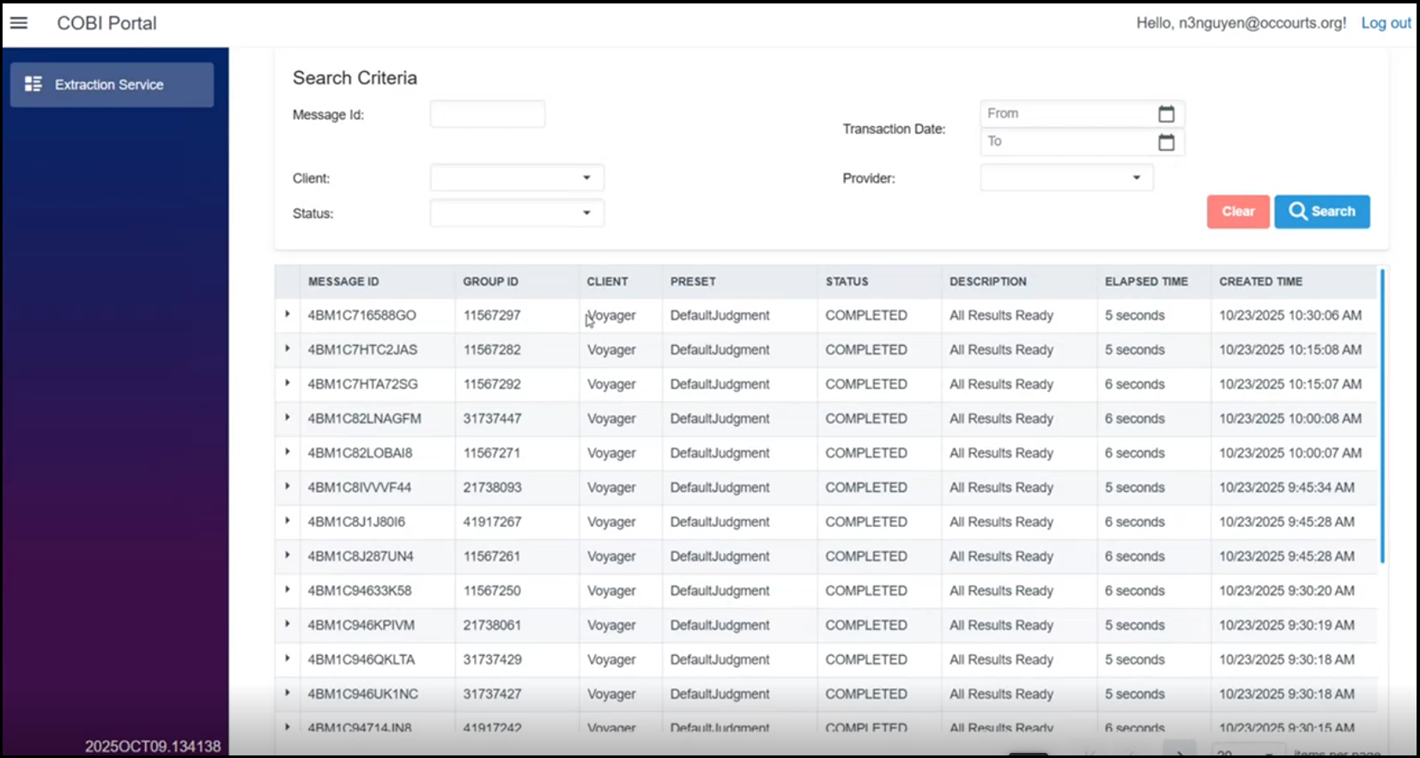
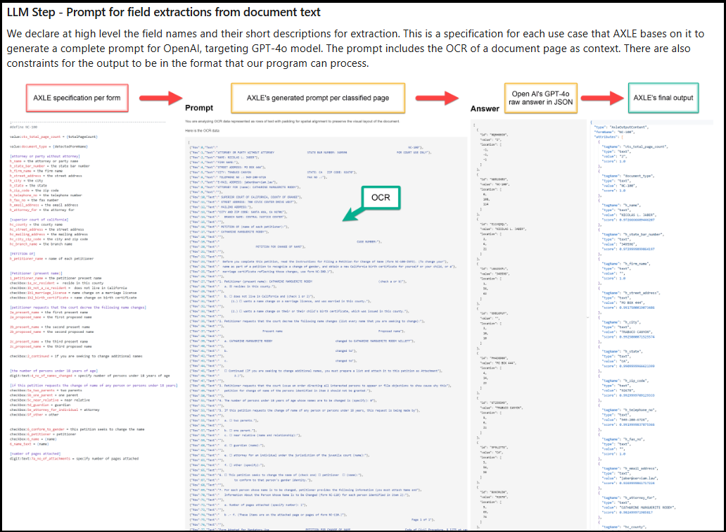
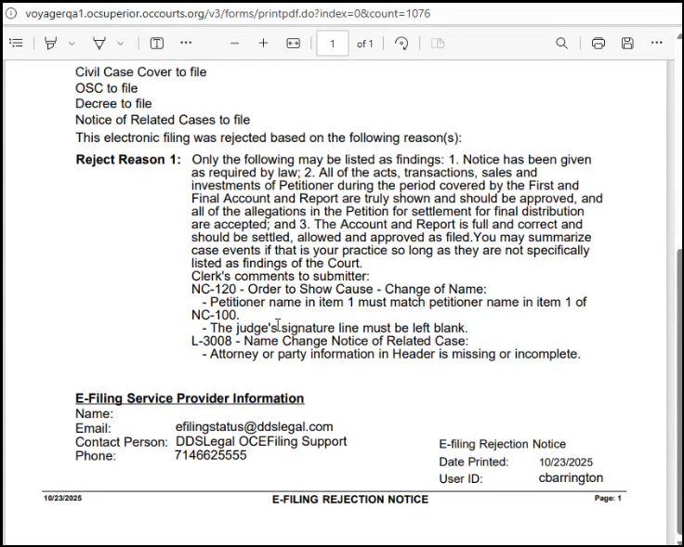
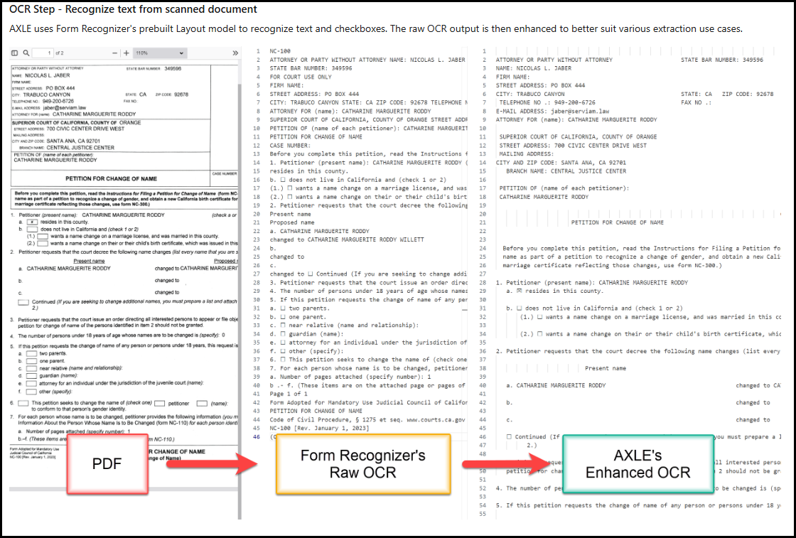

Slide 7
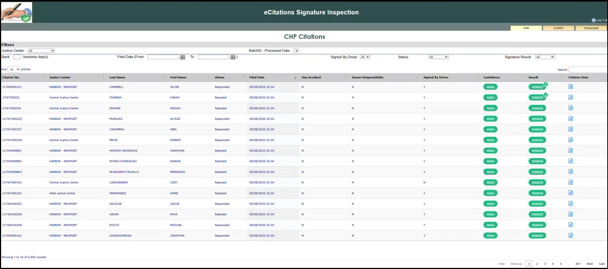
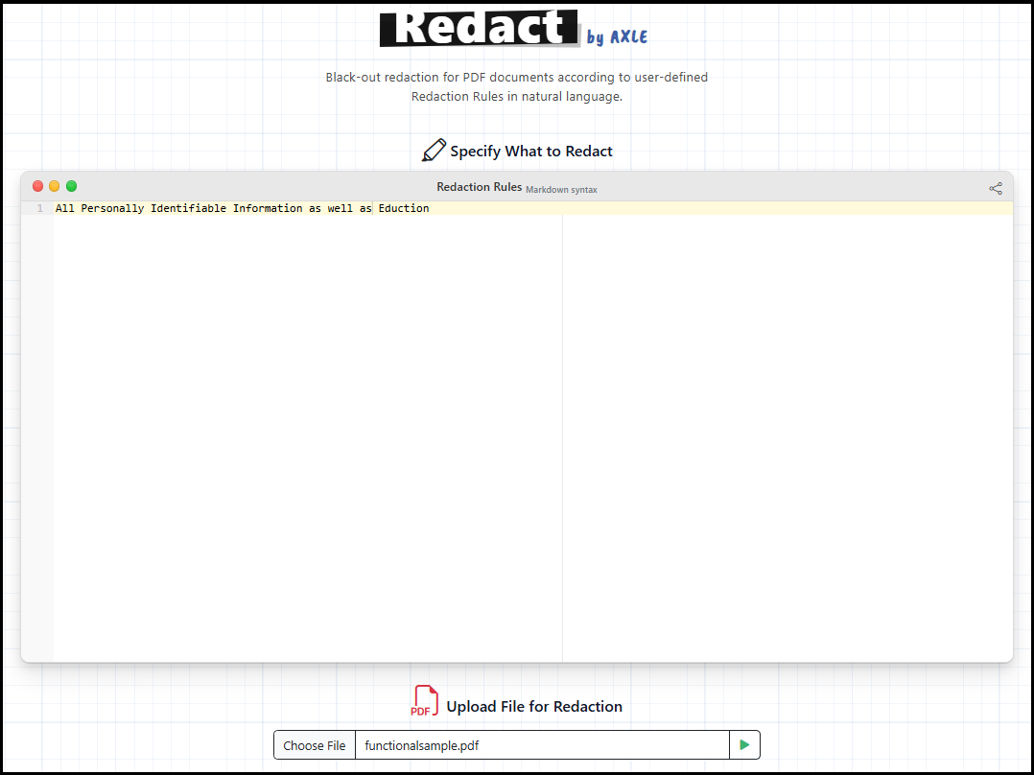
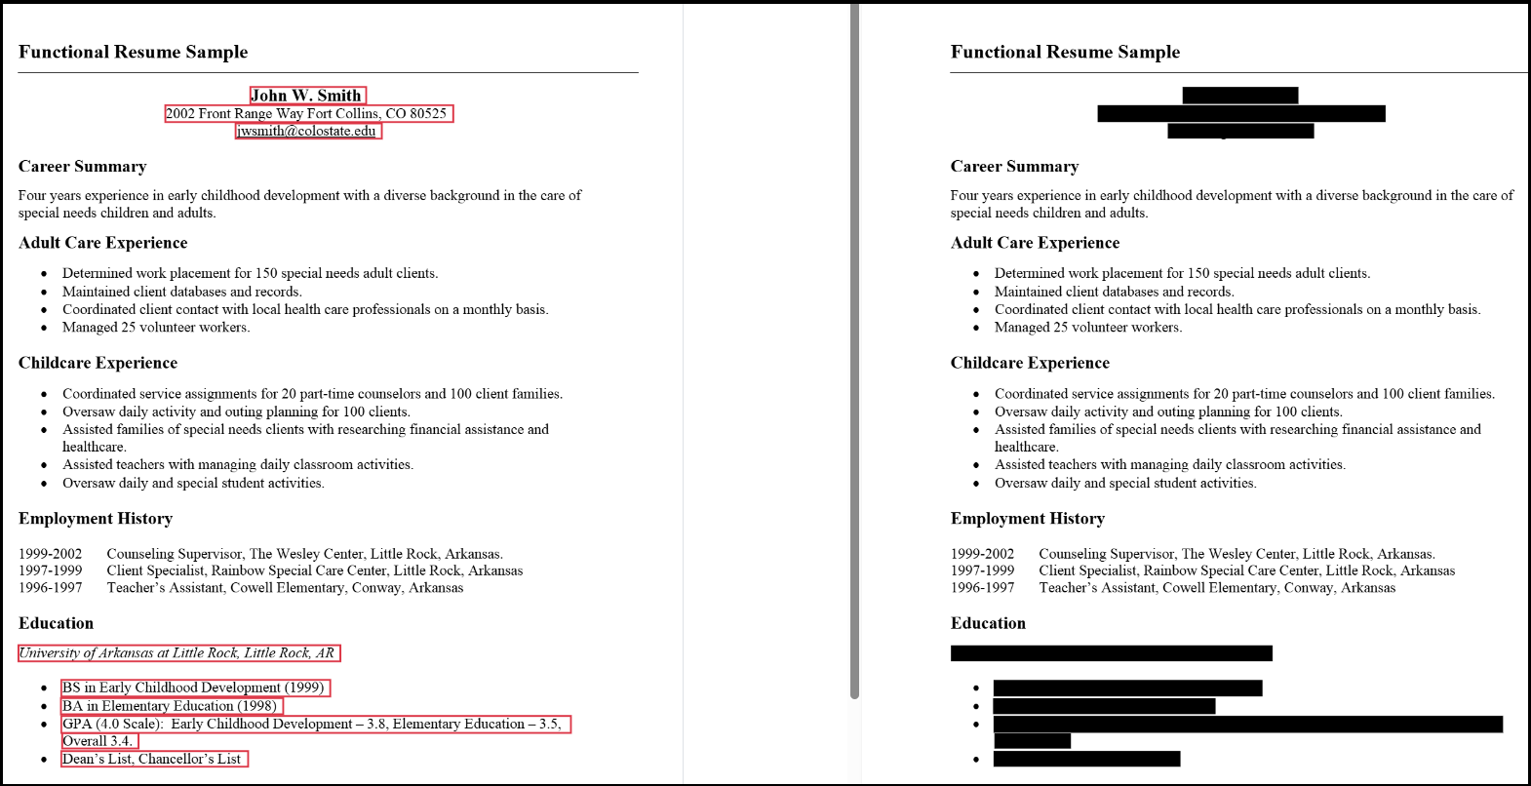
Future use cases
1. eCitations Signature Verification – Detect missing officer signatures (10,000+/mo)
2. HR Redaction – Automatic redaction of sensitive data
3. LLM-Driven Rule Logic – AI processes rules + documents for direct outcomes

Slide 8
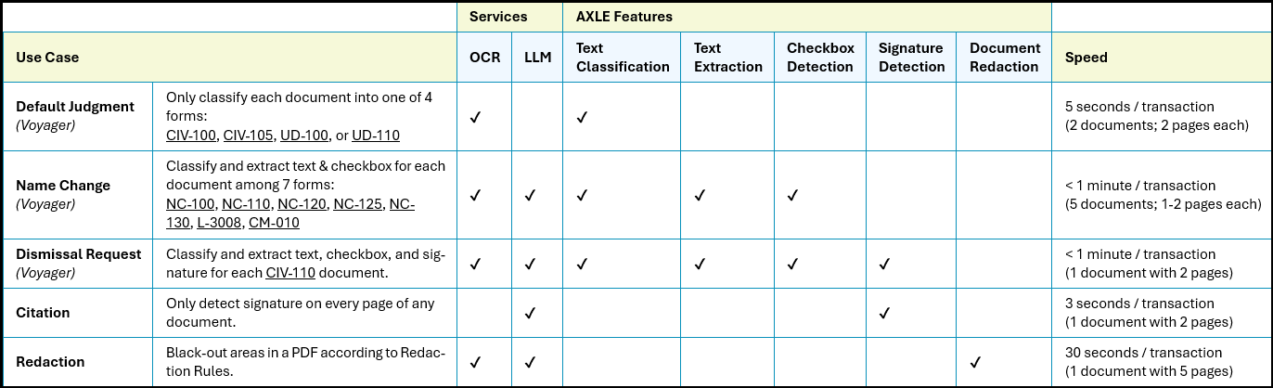
Key outcomes
✅ Simplified architecture (from 20+ services to modular AI stack)
✅ Reduced cost & maintenance
✅ 70%+ improvement in review efficiency
✅ Reusable modules (OCR, Signature Detection, Redaction)
✅ Scalable AI services foundation

Slide 9
Thank you!

Slide 10





AI Services Progression over time
AI Studio + API
EVA
EMI
Specialized Reviewer
Rule Engine Evaluator (flag)
Document Analysis
Agentic Approach
Artifact Generation
Multi-Document Analysis
Complex Rule analysis
Multi-Agent Approach
Artifact Generation
Document Q&A
Document Re-Ranking
User-Specific Context
MCP Server
Document Q&A
Document Re-Ranking
Discover Use Cases
Document Q&A
Learn about chatbots

Slide 11
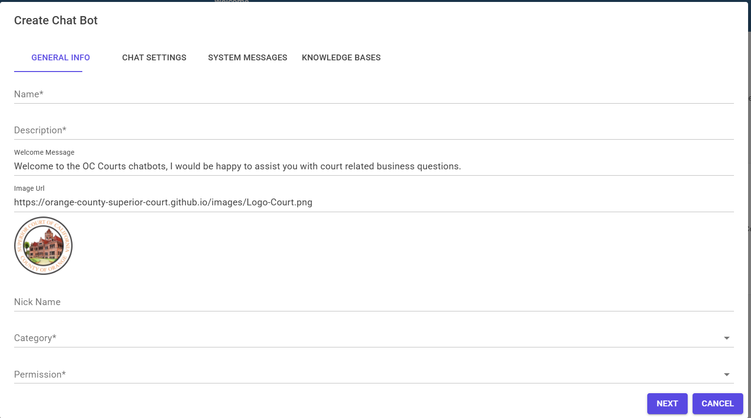
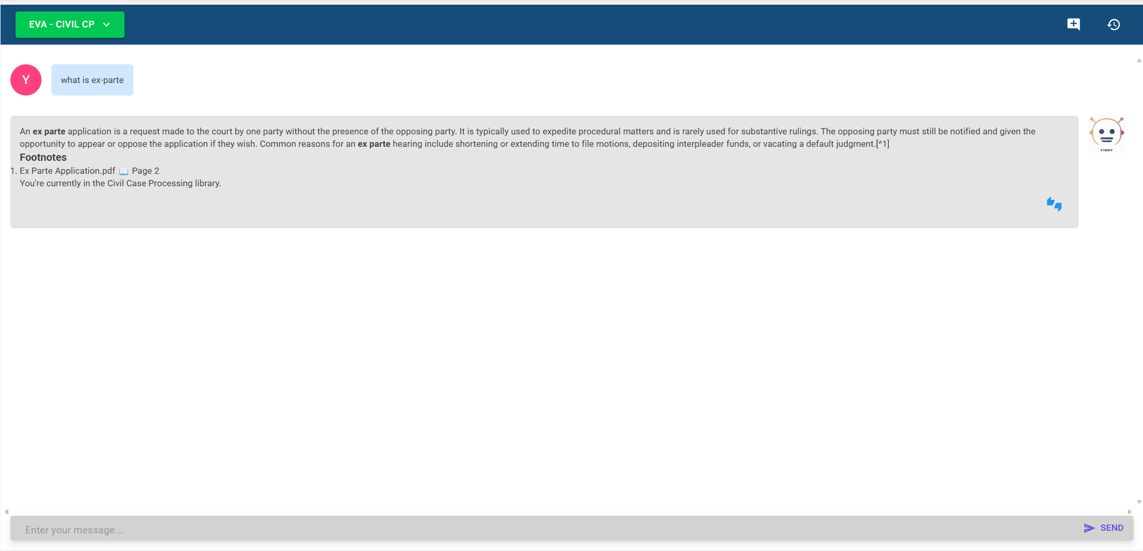
AI Studio / AI services API
Internal AI Studio (OC Courts)
Configurable and flexible chatbot settings
AI Services API for document Q&A functionality
Deployed underlying infrastructure needed to support functionality (vector db, azure open ai…etc)
Client deployment agnostic to support multiple clients (MS Teams & Web App)

Slide 12
AI Studio / AI services API and it’s Purpose
No code platform to explore use cases
Quick Evaluation cycles
Easily portable when ready for implementation
Choosing Ideas to Evaluate
Idea Submission
Write up POC
Evaluate POC in Studio
Eval POC in Client App
Post Eval. Write Up (ROI,Cost)
Project Kickoff
Approval Process
Cost Analysis, ROI, Timeline
Quick Eval of Practicality
Recommend POC or Not
Full POC w/ Integration of Client App

Slide 13
Definitions / terminology
RAG – Retrieval Augmented Generation (RAG) is a technique that enhances LLMs by integrating them with external data sources¹
MCP Servers - are programs that expose specific capabilities to AI applications through standardized protocol interfaces²
Citations:
¹ What is Retrieval Augmented Generation (RAG)? | DataCamp
² Understanding MCP servers - Model Context Protocol

Slide 14
Easy virtual Answers (EVA)
EVA helps staff answer procedural questions instantly.
Instead of flipping through procedure repositories or asking a supervisor:
Staff just ask EVA in Microsoft Teams
It provides vetted, step-by-step answers
Covers Civil, Probate, Family Law, Criminal and Juvenile procedures
Streamlines operations across case types
Launched in June 2024

Slide 15
EVA and Its Approaches
Enhanced RAG Approach to cover page overlaps and prevent content loss across sections
Re-ranking of document matching and section matching
Answers with citations of specific documents / sections used
Q&A
Ask Question
Get Relevant Context
Embed Query
Retrieve Similar Vectors
Construct Prompt with Context
Generate Response
Send Prompt with Context
Return Results
Azure Open AI
Vector DB
Client
Abstraction Layer (API)

Slide 16
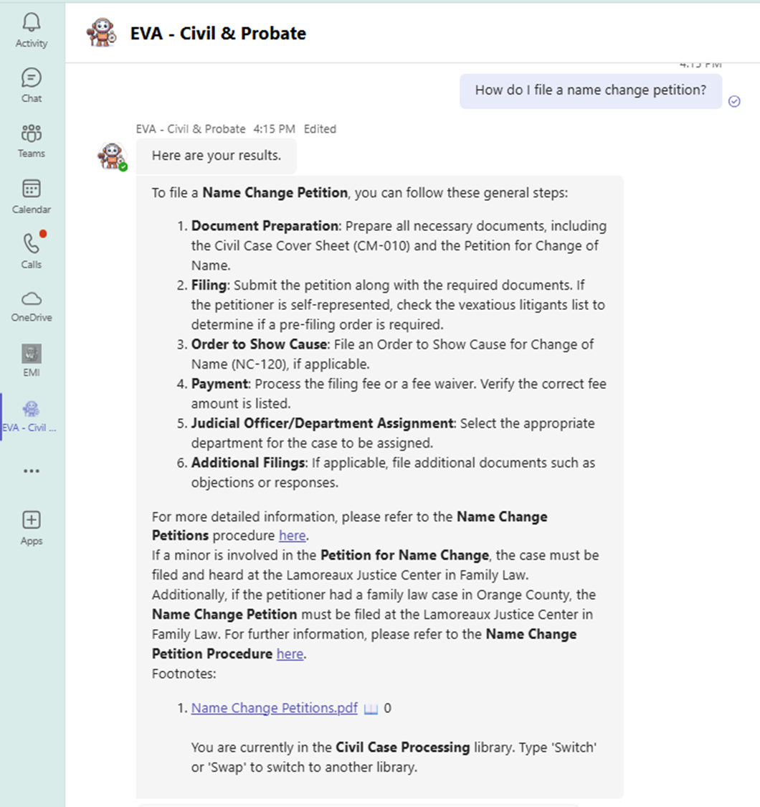
EVA in ACTION
“How do I file a request for interpreter?”
“How do I route a vexatious litigant?”
“What does DRAP mean?”
“How do I schedule a menacing dog appeal?”

Slide 17
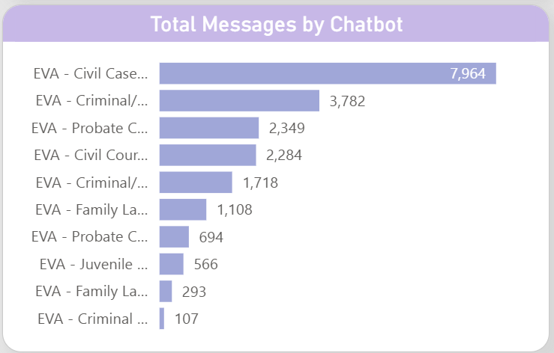
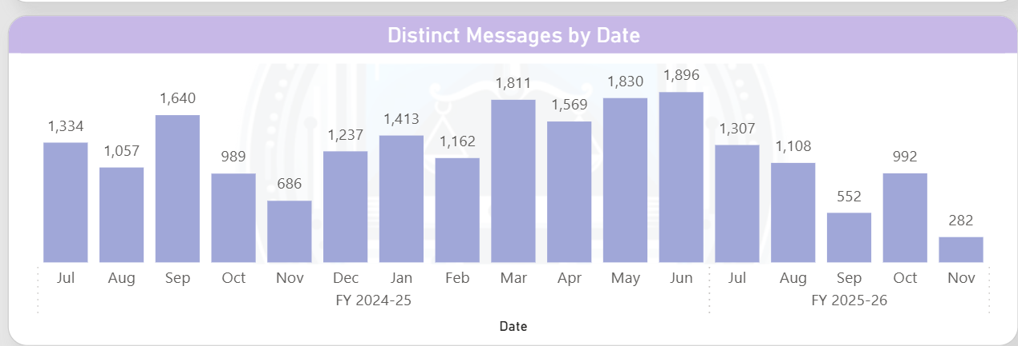
EVA Outcomes
From June 2024 to Nov 2025:
Over 10,000 guidance messages
330+ staff have used EVA
Built on 150+ procedures, with new ones added regularly per case type
Reduces training time and escalations
Improves public-facing service confidence

Slide 18

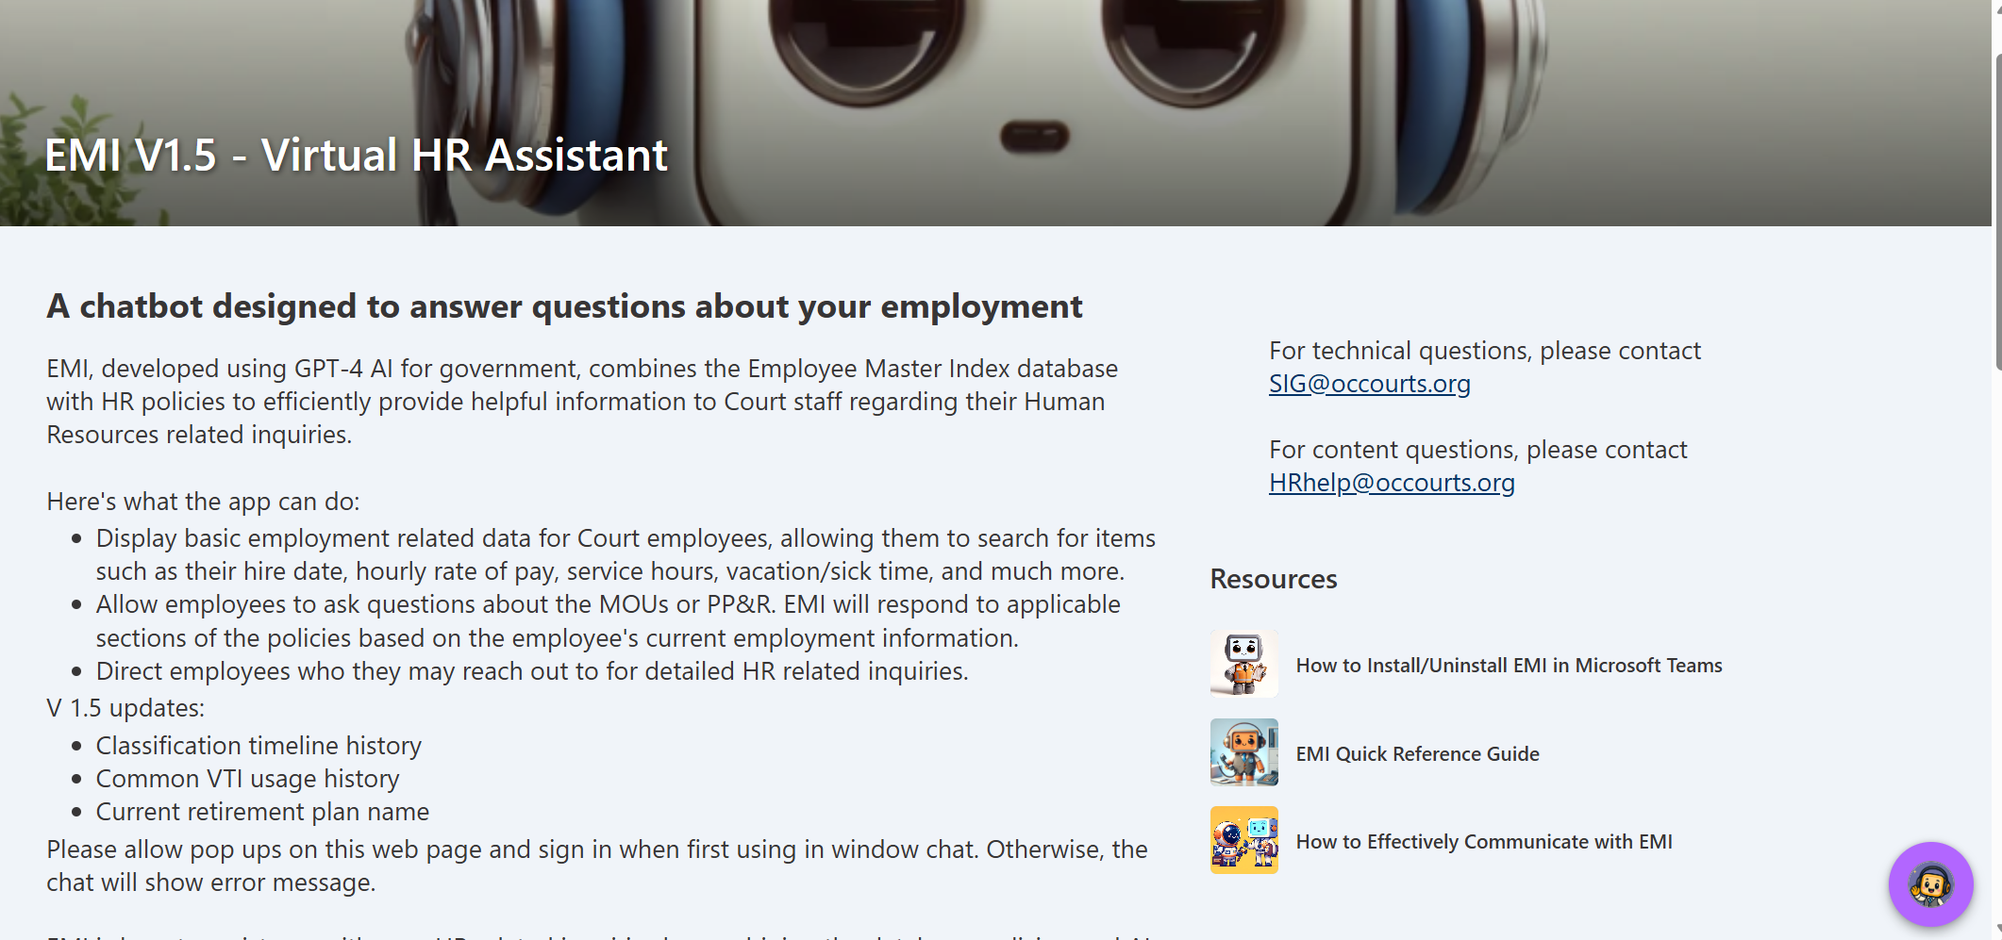
EMI (HR Chatbot)
Launched in November 2024:
MOUs and HR policies
Answer questions based upon specific user profile (e.g. start date, pay step, vacation hours, etc.)
Leave rules
Travel reimbursement info

Slide 19
EMI and it’s Approaches
Document specific filtering based upon bargaining unit (management, interpreters…etc)
Retrieval of user profile based upon OAUTH2 protocol
MCP to connect to HR data (tool → API → Database)
Q&A
Ask Question
Get Relevant Context
MCP Server (AAD)
Retrieve User Profile
Construct Prompt with Context
Generate Response
Send Prompt with Context
Return Results
Azure Open AI
Document RAG

Slide 20
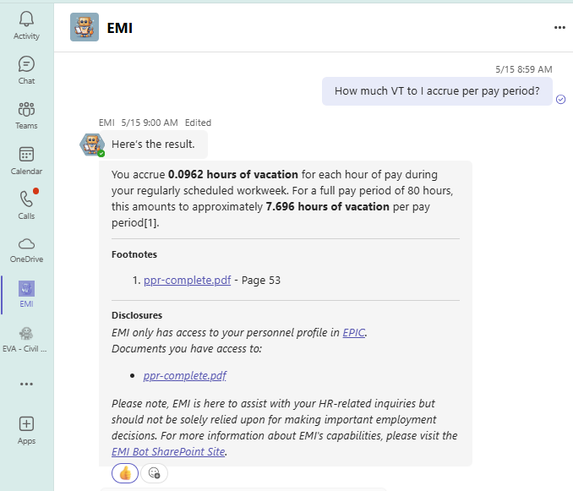
EMI In action
How much vacation do I accrue?
How much sick time do I have?
When is my next performance review?

Slide 21
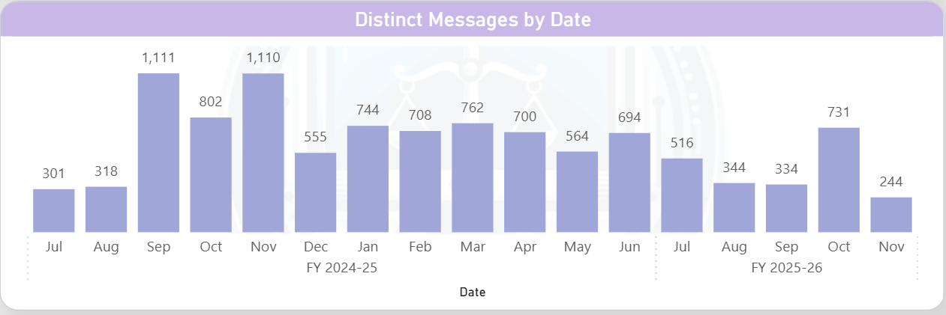
EMI outcomes
Since launch of July 2024:
10,000+ HR-related questions answered
464 staff members used it
Cuts down email requests and bottlenecks
Helps supervisors support staff more accurately
Improves consistency across departments

Slide 22
Specialized Reviewer
Specialized Reviewer is intended to:
Reduce back and forth between writers and reviewers
Review document based upon template guidelines
Take on the persona of the specific training team preferences
Implement an agentic approach to problem solving
Iterate over the entire uploaded document
Provide a comprehensive analysis / recommendation
Notes:
Probate Investigation Reports
Conservatorship
Guardianship

Slide 23
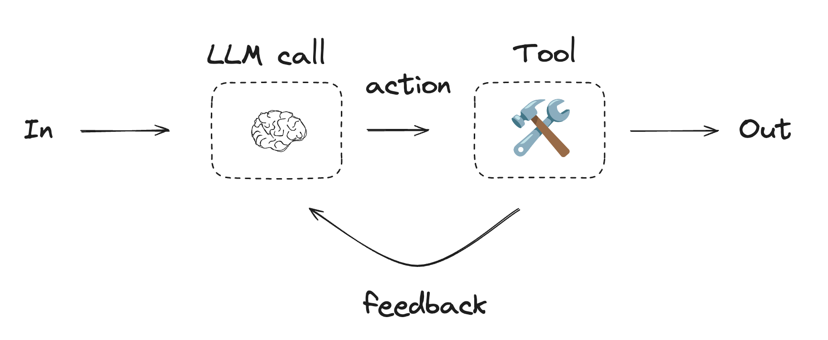
Specialized Reviewer and its Approaches
Approaches
Understand business rules / document structure
Agentic Approach to iterate over each page
Generate an aggregated analysis to return complete document to user
Long-context response by combining small responses together

Slide 24
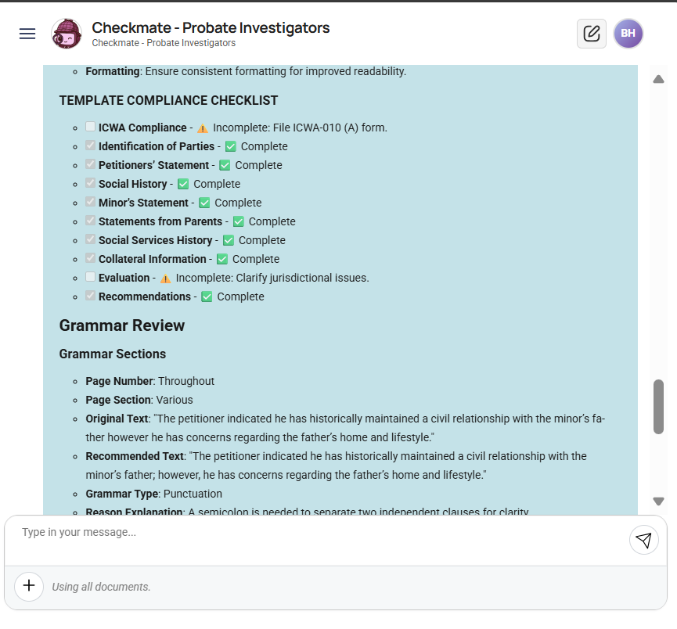
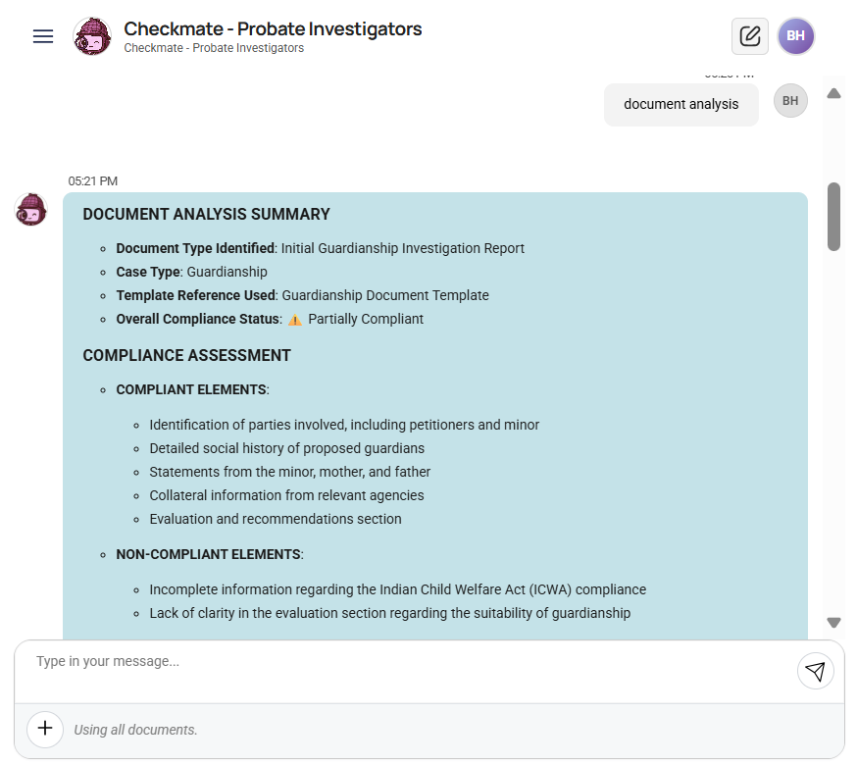
Specialized GPT In Action
Notes:
Want to show eva and why naïve rag doesn’t work here. You need to iterate over entire context.

Slide 25
Rule Evaluation Engine
Overview:
Review document packet (multi-documents) based upon rules
Provide a comprehensive analysis / rule determination
Provide an easily portable and adaptable solution for new rule engines
Different Types of Rules:
Evaluate within document value validation
Evaluate cross-document value validation
Evaluate document attachment validation
Notes:
Want to show eva and why naïve rag doesn’t work here. You need to iterate over entire context.

Slide 26
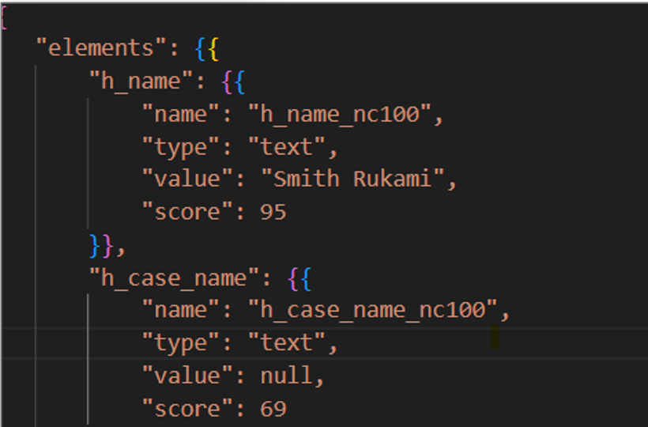
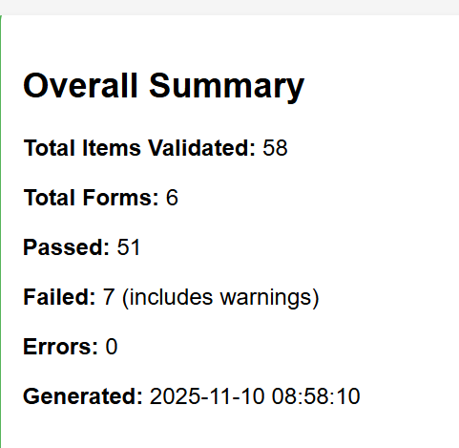
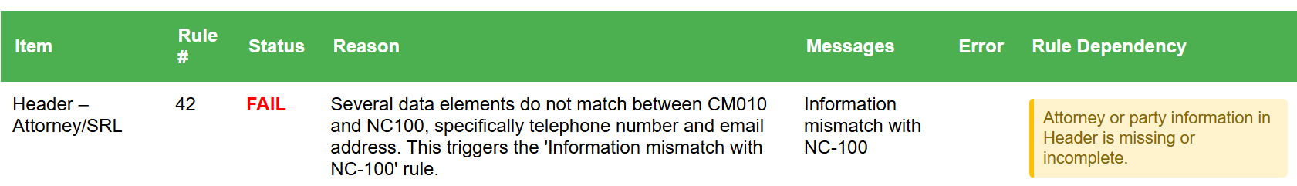
Rule Evaluation Engine
Approach:
Understand business rules / document structure
Identify rule-dependent values
Decompose / Extract out rule-dependent values
Iterate over each rule to provide complete analysis
Long-context response with complete rule engine report
Notes:
Want to show eva and why naïve rag doesn’t work here. You need to iterate over entire context.

Slide 27
What’s Next on the Journey
Graph Databases
Can we better define relationships and get more context?
Multi-agent patterns
How can we connect all these agents?
Open-Source Model Evaluation
Cost reduction, Batch processing
Deep Agents
Scratch pads, longer running analysis…etc
Enhance Observability and Evaluation Suite
Comprehensive test scenarios (tool calling routing, agent routing, quality of answer)

Slide 28


From Legacy to Modern
An AI-Assisted Journey Migrating PowerBuilder to Blazor
Criminal and traffic court Management System Transformation
By Jorge Lichtenstein

Slide 29

The Challenge
Legacy challenges
Modernizing
Monolithic architecture
Tight coupling everywhere
Zero automated tests
Desktop-only deployment
No documentation
Maintenance nightmare
Clean Architecture
Separation of concerns
Full test automation
Cloud-native (Azure Gov)
Living documentation
Maintenance & scalable

Slide 30

REQUIREMENT migrate it on the fly
We will swap out current legacy windows
Integrate new browser windows
Seamless change to end user

Slide 31
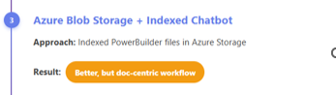
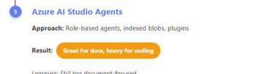
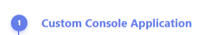
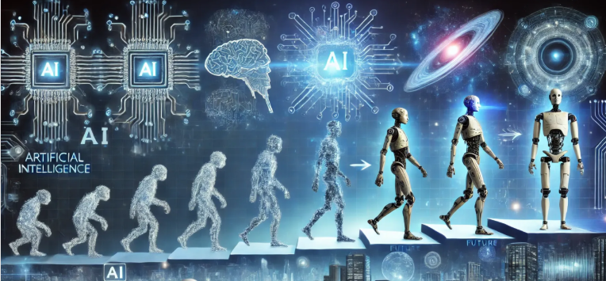
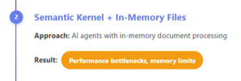


evolution
Setup & Go

Slide 32


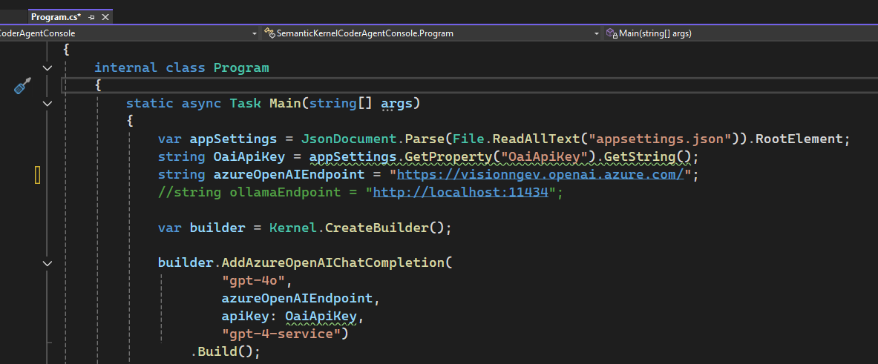
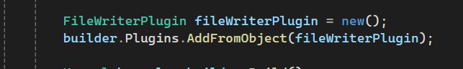
The AI-Assisted Journey
Evolution1: Creating a custom application
Using Kernel Memory
In memory vector store
Code Snippet
Issues
Loading files was too slow
Prompts were too broad, lots of hallucinations occurred
Generated documents lacked many of the business rules
Context limitations

Slide 33

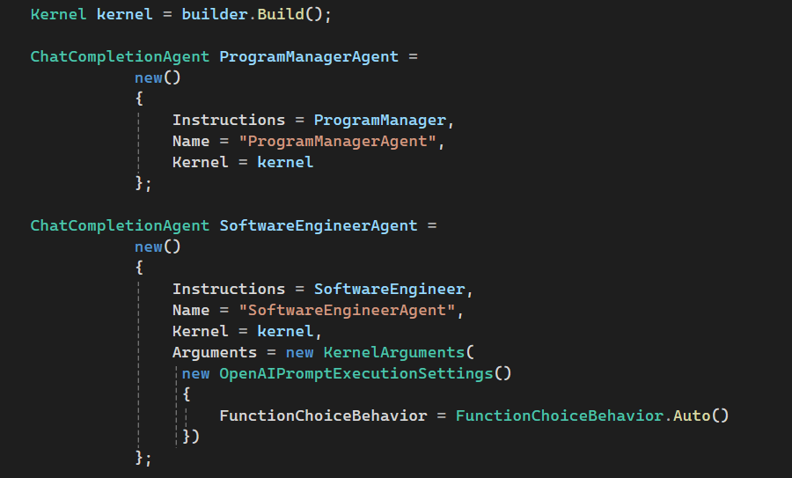
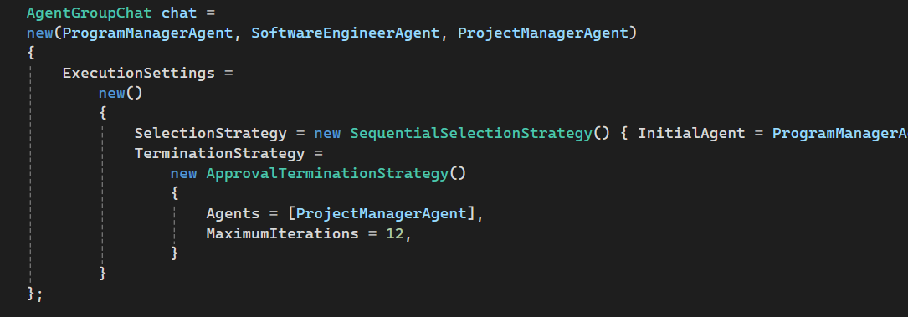
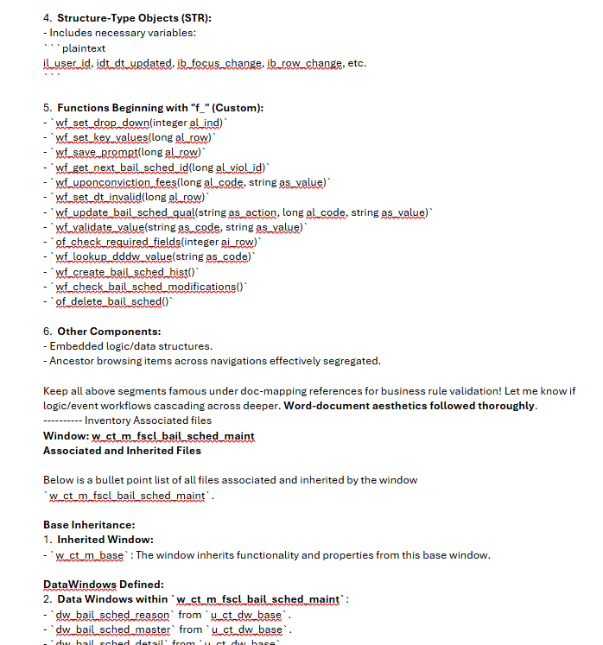
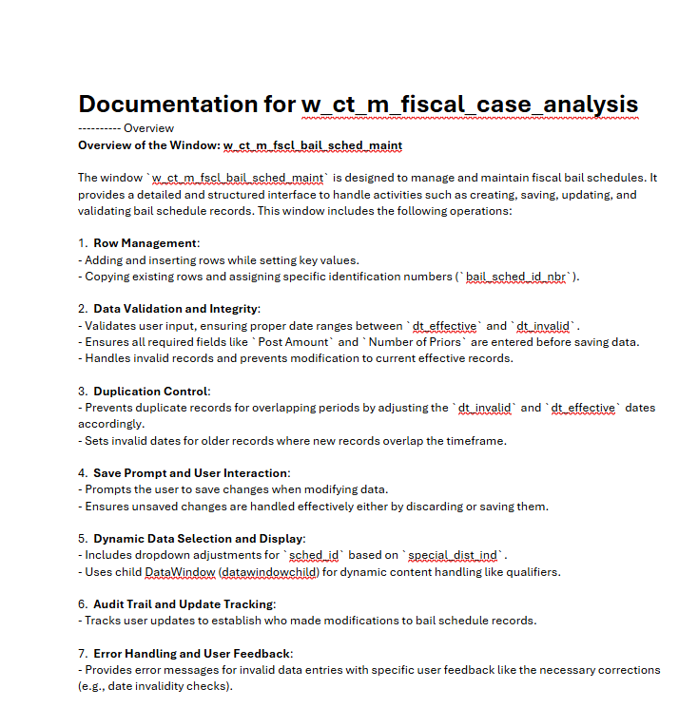
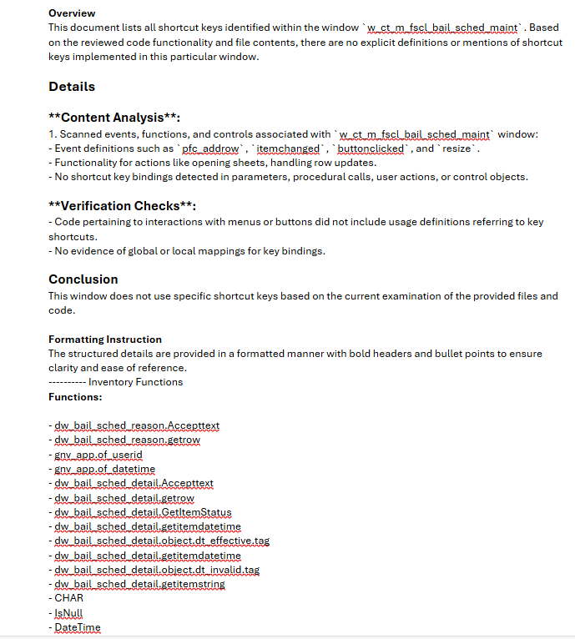
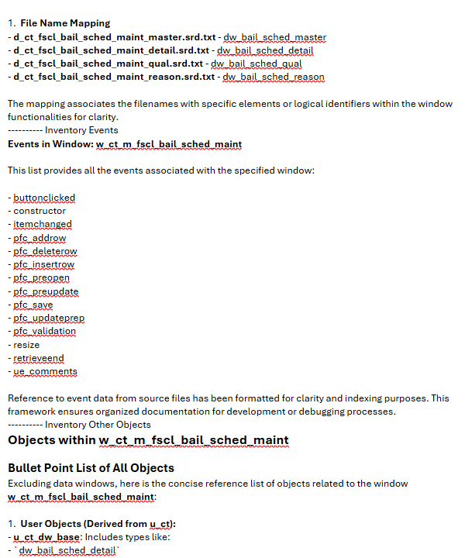
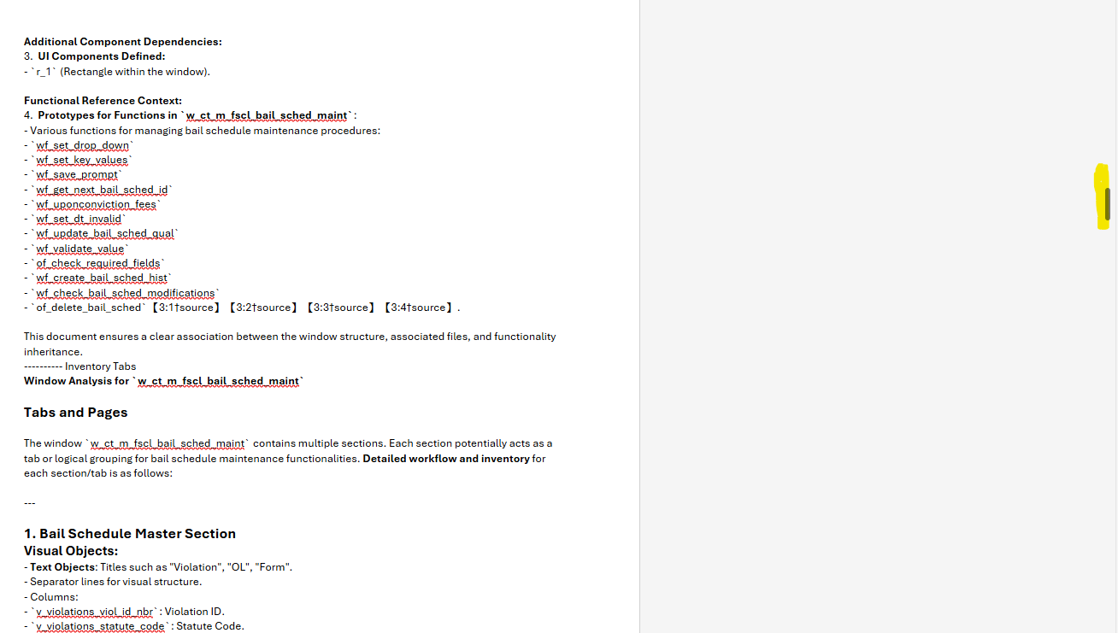
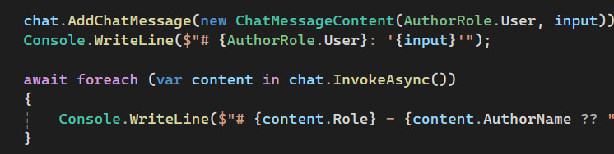
The AI-Assisted Journey
Evolution1: Creating a custom application
Evolution2: Semantic Kernel Group Chat + Indexed Blob Storage
Role based agents using Semantic Kernel Group Chat
Indexed files on Azure Blob Storage
Iterated code in pieces with group prompts
Code Snippet
Issues
Too much information for one file

Slide 34

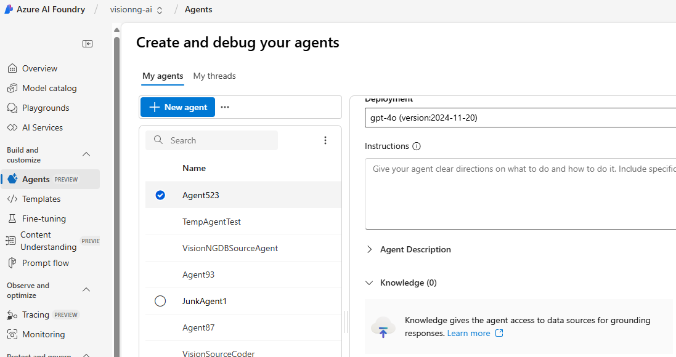
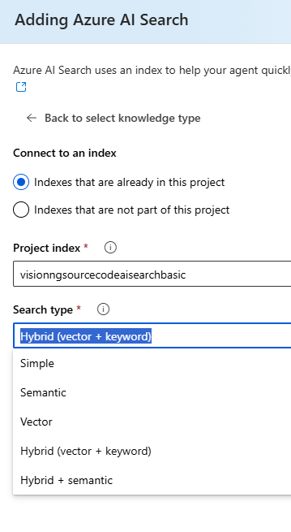
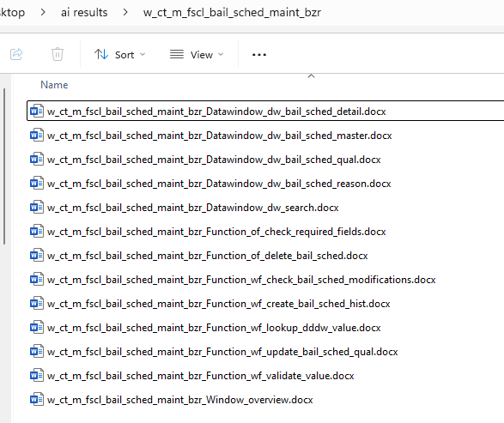
The AI-Assisted Journey
Evolution1: Creating a custom application
Evolution2: Semantic Kernel Group Chat + Indexed Blob Storage
Evolution 3: Powered by AI Studio
Moved Agents to Azure AI Foundation
Added Knowledge to agents Hybrid Vector + keyword
Issues
Splitting results into multiple sub files

Slide 35

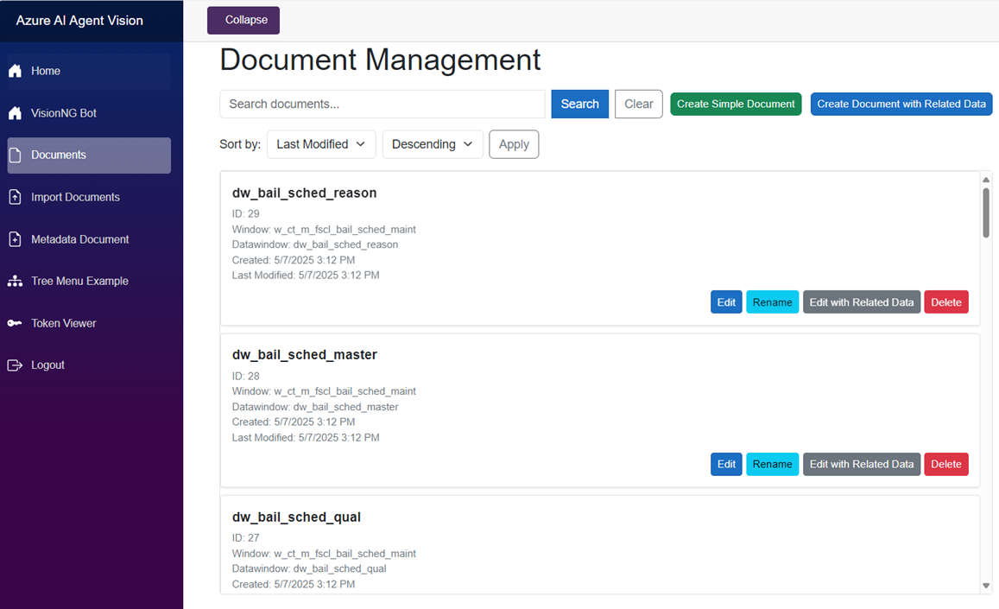
The AI-Assisted Journey
Evolution1: Creating a custom application
Evolution2: Semantic Kernel Group Chat + Indexed Blob Storage
Evolution 4: Document Management
Functionality to load AI generated files
Chatbot for instant knowledge retrieval
AI document feedback ready
Centralized knowledge base
More….
Evolution 3: Powered by AI Studio
Issues
Good for reference, but would not meet the needs required for rapid development.

Slide 36






The AI-Assisted Journey
Evolution1: Creating a custom application
Evolution 5: Agentic Tools
Evolution2: Semantic Kernel Group Chat + Indexed Blob Storage
Evolution 4: Document Management
Evolution 3: Powered by AI Studio
Iterations over time allowed tools to advance capabilities

Slide 37

The AI-Assisted Journey
Evolution 6: Selection
Evolution1: Creating a custom application
Evolution 5: Agentic Tools
Evolution2: Semantic Kernel Group Chat + Indexed Blob Storage
Evolution 4: Document Management
Evolution 3: Powered by AI Studio
Resolved
It is time to choose

Slide 38


🔬 The Great AI IDE Experiment

Slide 39

🏆 Why VS Code + GitHub Copilot Won

Slide 40

SET up & go

Slide 41




Source folder
Adding Context is fundamental

Slide 42



Model Context Protocol (MCP)

Slide 43



Using prompts
Generic
Details
Checks and balances

Slide 44



Using prompts

Slide 45


Using prompts
Sample prompt

Slide 46

VisionNG WITH Clean Architecture

Slide 47
Patterns
MediatR ----> Mediator
Fluent Validations ----> Fluent Validations (MediatR) (Mediator)
Mapping data with Mapperly

Slide 48


Sonar Cloud – CODE COVERAGE

Slide 49

📊 Real Impact & Results

Slide 50




Integration

Slide 51

💡 Key Lessons Learned

Slide 52




🔄 Our Migration Pipeline

Slide 53

📋 Recommendations for Your Team

Slide 54

🎉 Key Takeaways

Slide 55


Slide 56
Thank you Questions?

